Slide 1
A Few Sample Digital Humanities Projects
Every DH project consists of three components: data (for example, the handwritten letters of Charles Darwin), processing of that data (transcribed, digitized, cataloged, visualized), and presentation of that processed data.
With so many to choose from, we present a few here that exemplify the nature and variety of digital humanities projects.
Darwin Correspondence Project
https://www.darwinproject.ac.uk/
“Read and search the full texts of more than 9,000 of Charles Darwin’s letters, and ﬁnd information on 6,000 more.”

Slide 2
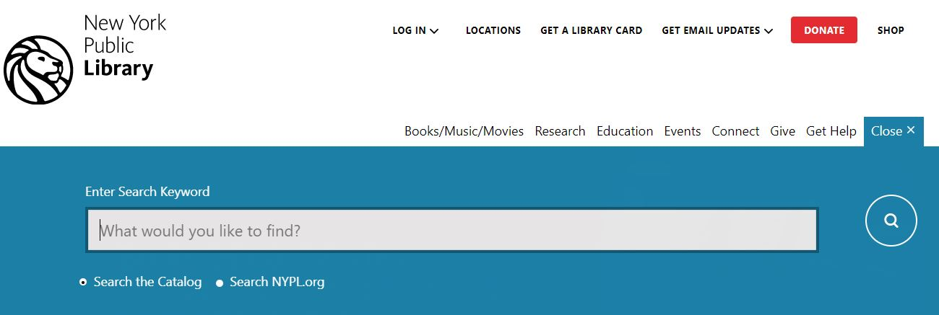
New York Public Library Catalogue
https://catalog.nypl.org/
You might search for “digital humanities” and see the 260+ items that come up. Or, check out your own public library’s online catalog. Did you know an online catalogue can be a DH project?

Slide 3
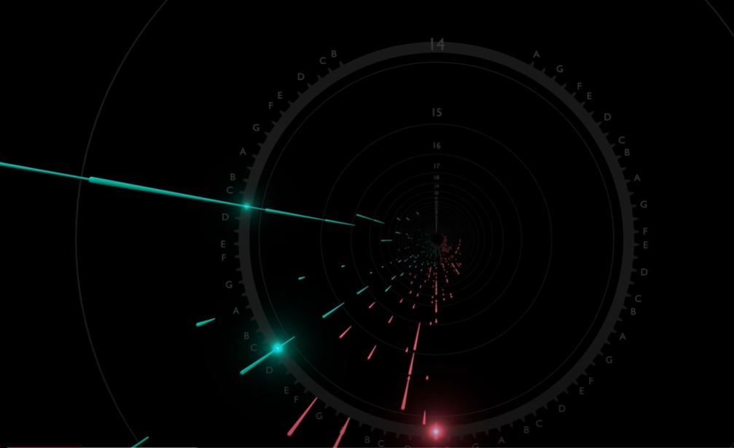
Franz Liszt’s Hungarian Rhapsody 2
https://www.youtube.com/watch?v=m6xWGVhZl1g
Visualization of Liszt’s piano composition, created by “andy fillebrown” … the data is Liszt’s composition: musical notes!

Slide 4
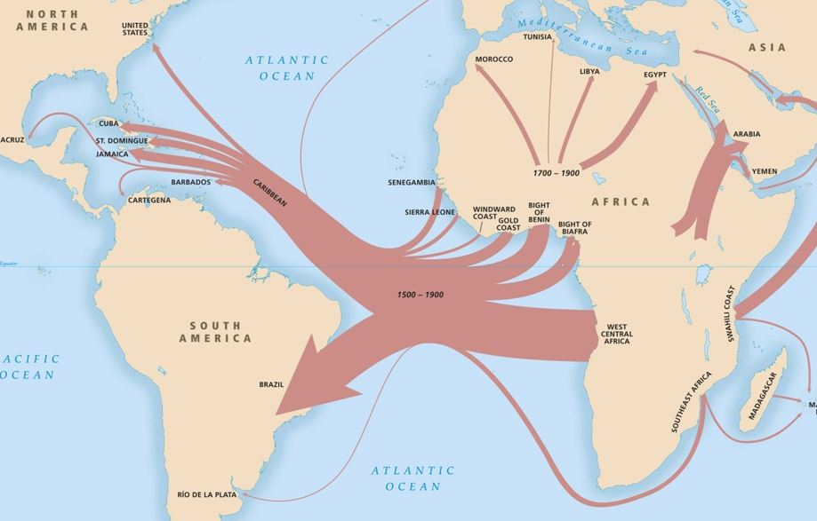
Slave Voyages
https://slavevoyages.org/
“Explore the Dispersal of Enslaved Africans Across the Atlantic World: This digital memorial raises questions about the largest slave trades in history and offers access to the documentation available to answer them.”

Slide 5

Explore a few traditional humanities projects funded by the National Endowment for the Humanities (NEH): https://www.neh.gov/our-work/listing?f%5B0%5D=content_type%3Aproject
Now explore a few digital humanities projects funded by the NEH’s Office of Digital Humanities: https://www.neh.gov/our-work/listing?f%5B0%5D=content_type%3Aproject&f%5B1%5D=our_work_division_office%3A346

Slide 6
More DH Project Examples -- Explore On Your Own
American Panorama: At Atlas of United States History, http://dsl.richmond.edu/panorama/
Dig That Lick: Analysing Large-Scale Data for Melodic Patterns in Jazz Performances, http://dig-that-lick.eecs.qmul.ac.uk/
Endangered Languages Project: A Worldwide Collaboration to Strengthen Endangered Languages, http://www.endangeredlanguages.com/
Europeana: Discover Inspiring cultural heritage from European museums, galleries, libraries and archives. https://www.europeana.eu/en
Fashion and Race Database: An Accessible, Academic Treatment to One of Fashion’s Most Critical Topics Facing Us Today, https://fashionandrace.org/database/
Flowing Data: Explores how we use analysis and visualization to understand data and ourselves., https://flowingdata.com/
Holocaust Geographies Collaborative [Uses mapping and geography to examine spaces and places of the Holocaust], https://holocaustgeographies.org/

Slide 7
Kindred Britain: A Network of nearly 30,000 Individuals Connected through Family Relationships of Blood, Marriage, or Affiliation, http://kindred.stanford.edu/
London Lives: A Comprehensive Electronic Edition of Primary Sources on Criminal Justice and the Provision of Poor Relief and Medical Care in Eighteenth-Century London, https://www.dhi.ac.uk/projects/london-lives/
Mapping Inequality: Redlining in New Deal America, http://dsl.richmond.edu/panorama/redlining/
Most Timeless Songs of All-Time: Using Spotify to Measure the Popularity of Older Music, https://pudding.cool/2017/03/timeless/index.html
Perseus Digital Library [history, literature and culture of the Greco-Roman world], http://www.perseus.tufts.edu/hopper/opensource
Salem Witch Trials: Documentary Archive and Transcription Project, http://salem.lib.virginia.edu/home.html
Slavery Images: A Visual Record of the African Slave Trade and Slave Life in the Early African Diaspora, http://www.slaveryimages.org/s/slaveryimages/page/welcome

Slide 8
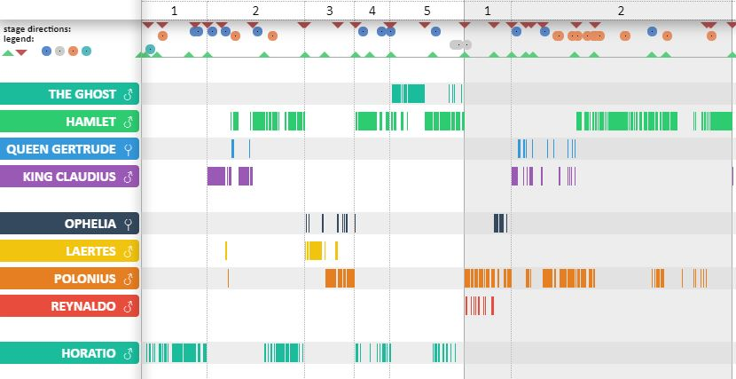
Spatial History Project, https://web.stanford.edu/group/spatialhistory/cgi-bin/site/index.php
Spread of U.S. Slavery, 1790 – 1860, https://lincolnmullen.com/projects/slavery/
Story Maps and the Digital Humanities, https://collections.storymaps.esri.com/humanities/
Visualising Hamlet - To See or Not to See, http://www.thomaswilhelm.eu/shakespeare/output/hamlet.html

